Slide 1
Predicting weather caused train delays
CS-E5710-Bayesian_Data_Analysis project
Team InterCity
Viet Nguyen, Roope Tervo

Slide 2

Image: Solita Oy
Notes:
Train delays are important to predict so that rail traffic operations center are able to prepare (put more workforce on field, reduce train shifts)
Most of severe train delays are caused by bad weather
The issue has been studied only a little, one similar study has been done in Northern Italy
They was able to predict train delays based on few weather parameters using methods based on Random Forests

Slide 3
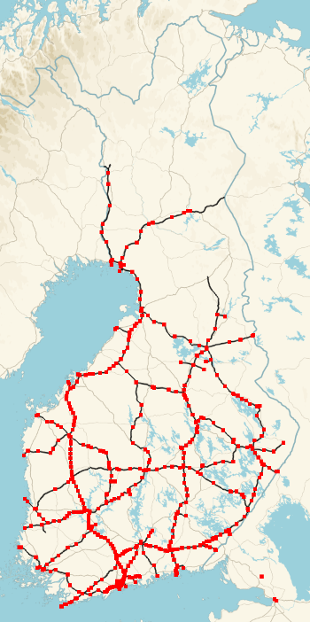
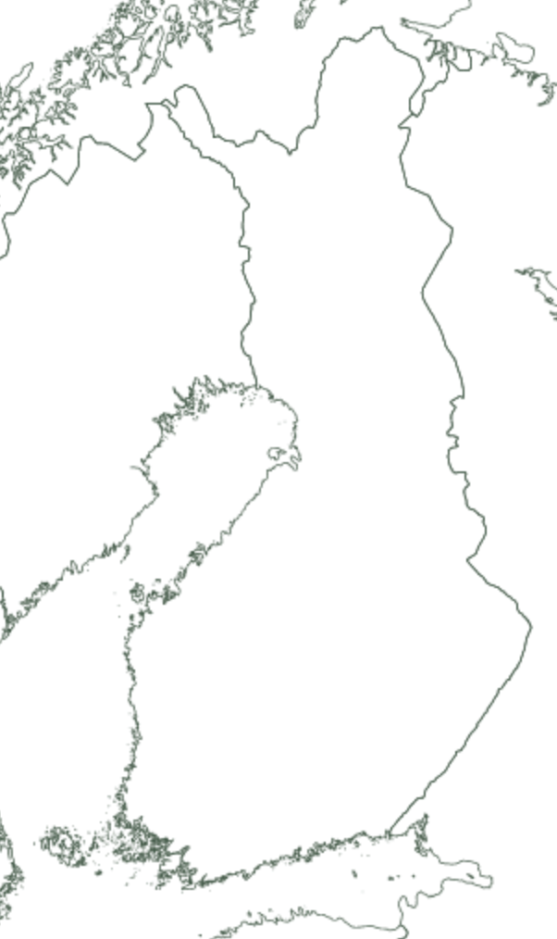

Label data consists of trains delayed between stations
End: +6 min
Data from 2010 – 2018
1 station (Helsinki)
41 255 rows
Only passenger trains considered
Mid 2: +12 min
Mid 1: +0 min
Start: +0 min
Image: Roope Tervo 2018, license CC4, Data Liikennevirasto (CC4)
Image: Roope Tervo 2018, license CC4, Data Maanmittauslaitos (CC4)
Notes:
Our dataset is got from Finnish Traffic Agency (FTA)
The dataset contains train delay information from 2010 to 2018 and corresponding weather information
All trainstations
4 different train types
In total almost 30 million rows
19 weather parameters
We use here only Helsinki railway station and passenger trains

Slide 4
Using bayesian linear regression to model delays
5 parameters selected to as features
Temperature, snow depth, wind gust, wind direction, visibility
Selection done both based on histogram analysis and assumptions on remarkable parameters
Notes:
We picked 5 parameters to as features
Selection was done partly based on assumptions on remarkable parameters and based on histogram analysis
In the example images:
blue stands for all cases in the dataset (for current parameters)
red stands for rows with over 50 minutes accumulated delay (= sever rail traffic disruption)
Difference in histograms gives a hint that the particular parameter affects on train traffic
We also tried one model with fewer parameters (temperature, snow depth, wind direction, 6h precipitation sum)

Slide 5
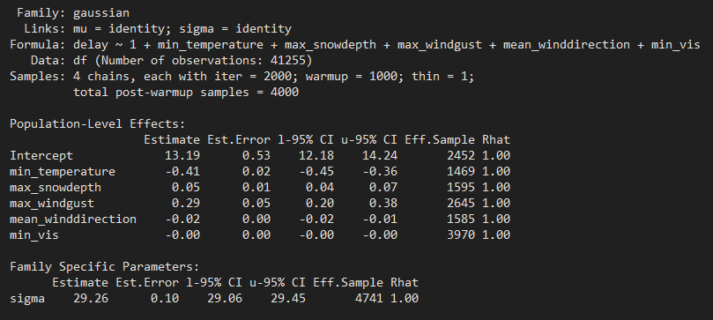
Model summary

Slide 6
Description of the prior choices
In the first model, we use the default prior: non-informative flat prior over the reals.
In this case we decide to let the data speak for itself
Weakly - informative and highly - informative prior were expreminented in the sensitivity analysis section

Slide 7
Models converged well
Rhat below 1.1. and effecive sample size over 0.1
Different chains looks converged as well
Notes:
We did convergence analysis by plotting the model and looking posterior distributions and different chains, using effective sample size and rhat analysis
Model is well converged

Slide 8
Fitted model do not represent observed data
Model misses large amount of zero values
Notes:
Observed data and fitted distributions do not look like the same
Model misses large amount of zero values
Model also gives negative values

Slide 9
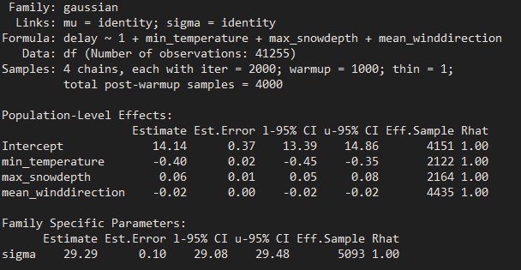
Model comparison…
Our second model includes only 3 predictors min_temperature , max_snowdepth, mean_winddirection

Slide 10
Sensitivity analysis
Weakly - informative and highly - informative prior were experimented
Weakly – informative prior selected based on estimate we get from previous model
Highly – informative prior selected based on our understanding of the data
For example, we believe that min_vis (mininmum vision) has more influence than min_temprature in causing train delay
Result: not much different in the posterior compared to previous model

Slide 11
The model has no real prediction skill
Observed and predicted delay for validation data
Black line for observations
Blue line for prediction

Slide 12
Different methods are required to predict weather caused train delays
Still, other methods has been succesfully used for the prediction
At least different model is required
Time series model (like bsts)
Random Forests
Gaussian processes with inducing points?
Bayesian models may be problematic because whole data can’t easily be used
Whole data takes huge amount of processing time and memory

